Slide 1
IoT based smart farm
D2R

Slide 2
Synopsis
Implementation of an IoT based hydroponics smart farm, incorporating a structure that combines the functionality of rain water harvestation, as well as solar energy harvestation. This modification helps us reduce the cost of setting up a traditional hydroponics farm, by efficiently making use of available natural resources.
Determining weather conditions and based on sensor readings, the “Flower” would be able to switch between functioning as a solar energy harvesting system, and a rain water harvesting system.
The solar energy that is harvested and stored, would in turn be used to power the smart farm, thus being able to set up a sustainable environment for plant growth making use of natural resources, reducing costs at the same time.
Plants use only certain regions of the light spectrum for growth. Hence using LED grow lights, we will be able to set up an indoor farm under a controlled environment, that can promote the 24*7 growth of crops. This can increase production and maximise profits.
Making use of the best combination of hydroponic nutrient solutions in the implemented hydroponics system, the rate of growth of certain crops can be improved, compared to that achieved by traditional growing techniques.

Slide 3
Flower
Other components
Solar energy
Rain water
Stored solar energy
Backup
Growth lights
Hydroponics system
And vertical farming
[Different sectors for different crops]
Nutrients
[different combinations for different sectors]
Water tank

Slide 4
INTRODUCTION
Farming in India is done using the mundane ways. The fact that most of our farmers lack proper knowledge makes it even more erratic. A large portion of farming and agricultural activities are based on predictions, which at times fail.
Since we know the benefits of proper soil moisture and its quality, air quality and irrigation; in the growth of crops, such parameters cannot be ignored.
We, therefore, have come up with a new idea of crop monitoring and smart farming using IoT. We believe that our concept will be a benchmark in the agribusiness due to its reliability and remote monitoring.
Our idea tries to digitalise farming and agricultural activities so that the farmers can check on the requirements of the crops and accurately predict their growth. This concept will surely accelerate their business to reach new heights and also be more profitable.

Slide 5
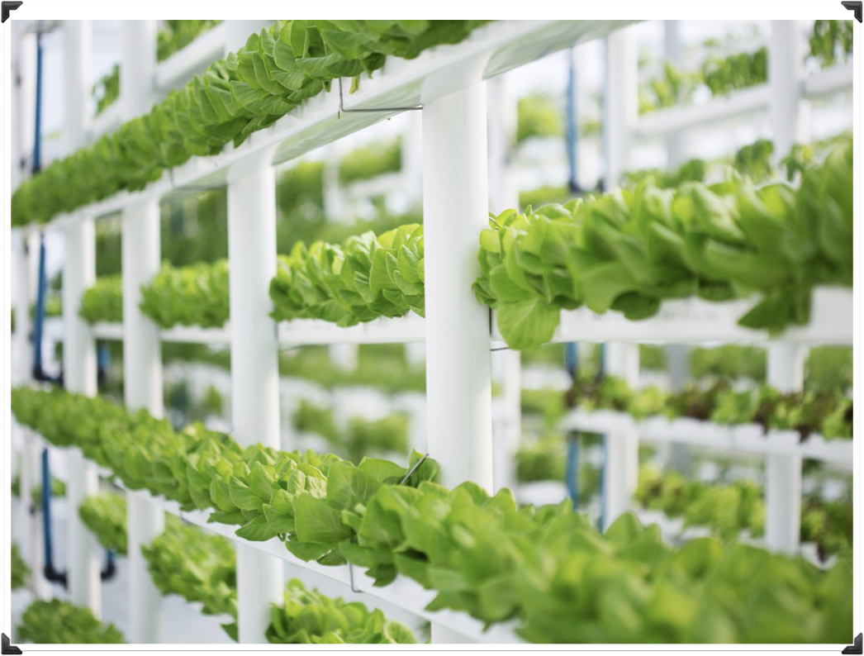
Hydroponics

Slide 6
Hydroponics
Method of growing plants in a water based, nutrient rich solution.
Hydroponics does not use soil, instead the root system is supported using an inert medium such as perlite, rock wool, clay pellets, peat moss, or vermiculite.
The basic premise behind hydroponics is to allow the plant roots to come in direct contact with the nutrient solution, while also having access to oxygen, which is essential for proper growth.

Slide 7
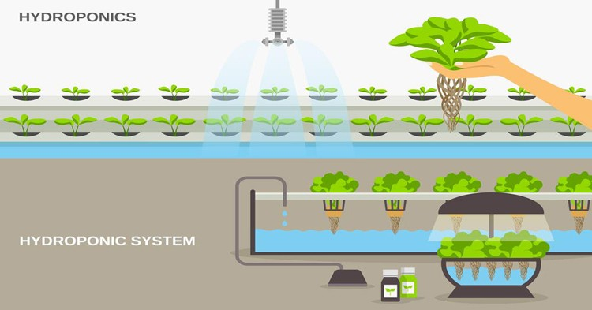
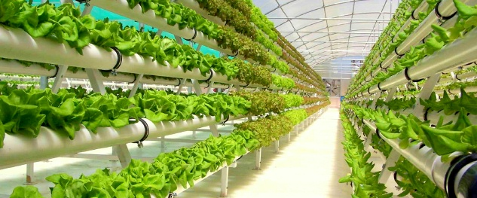

Slide 8
Advantages
Hydroponics
Greatly increased rate of growth in plants. With the proper setup, plants will mature upto 25% faster and produce upto 30% more than the same plants grown in soil.
Careful control of nutrient solution and pH levels.
A hydroponic system will also use less water than soil based plants because the system is enclosed, which results in less evaporation.
Reduces waste and pollution from soil runoff.
Improved pest control

Slide 9
Nutrient solution
Hydroponics
The hydroponic nutrient solution is the sole source of nutrients to the plant. Therefore, it is imperative to apply a balanced solution, that contains all plant nutrients, at the right balance.
Several important factors have to be considered when choosing fertilisers and preparing a hydroponic nutrient solutions:
Water quality - salinity, concentration of potential harmful elements (like sodium, chlorides and boron).
Required nutrients and their concentrations in the hydroponic nutrient solution.
Nutrient balance.
The pH of the hydroponic nutrient solution and its effect on uptake of nutrients by plants.

Slide 10
Common nutrient ranges in hydroponic nutrient solutions
Element | Ionic form absorbed by plants | Common range (ppm=mg/l)
Nitrogen | Nitrate (NO3-), Ammonium (NH4+) | 100-250 ppm elemental N
Phosphorus | Dihydrogen phosphate (H2PO4-), Phosphate (PO43-) Monohydrogen phosphate (HPO42-) | 30-50 ppm elemental P
Potassium | Potassium (K+) | 100-300 ppm
Calcium | Calcium (Ca2+) | 80-140 ppm
Magnesium | Magnesium (Mg2+) | 30-70 ppm
Sulfur | Sulfate (SO42-) | 50-120 ppm elemental S
Iron | Ferrous ion (Fe2+) Ferric ion (Fe3+) | 1-5 ppm
Copper | Copper (Cu2+) | 0.04-0.2 ppm
Manganese | Manganese (Mn2+) | 0.5-1.0 ppm
Zinc | Zinc (Zn2+) | 0.3-0.6 ppm
Molybdenum | Molybdate (MoO42-) | 0.04-0.08 ppm
Boron | Boric acid (H3BO3) Borate (H2BO3-) | 0.2-0.5 ppm elemental B
Chloride | Chloride (Cl-) | <75 ppm
Sodium | Sodium (Na+) | <50 ppm TOXIC to plants

Slide 11
Suggested Nutrient Solutions for Various Crops
Crop | N | P | K | Ca | Mg
Concentration in mg/l (ppm)
Tomato | 190 | 40 | 310 | 150 | 45
Cucumber | 200 | 40 | 280 | 140 | 40
Pepper | 190 | 45 | 285 | 130 | 40
Strawberry | 50 | 25 | 150 | 65 | 20
Melon | 200 | 45 | 285 | 115 | 30
Roses | 170 | 45 | 285 | 120 | 40
Suggested Nutrient Solutions for Various Crops

Slide 12
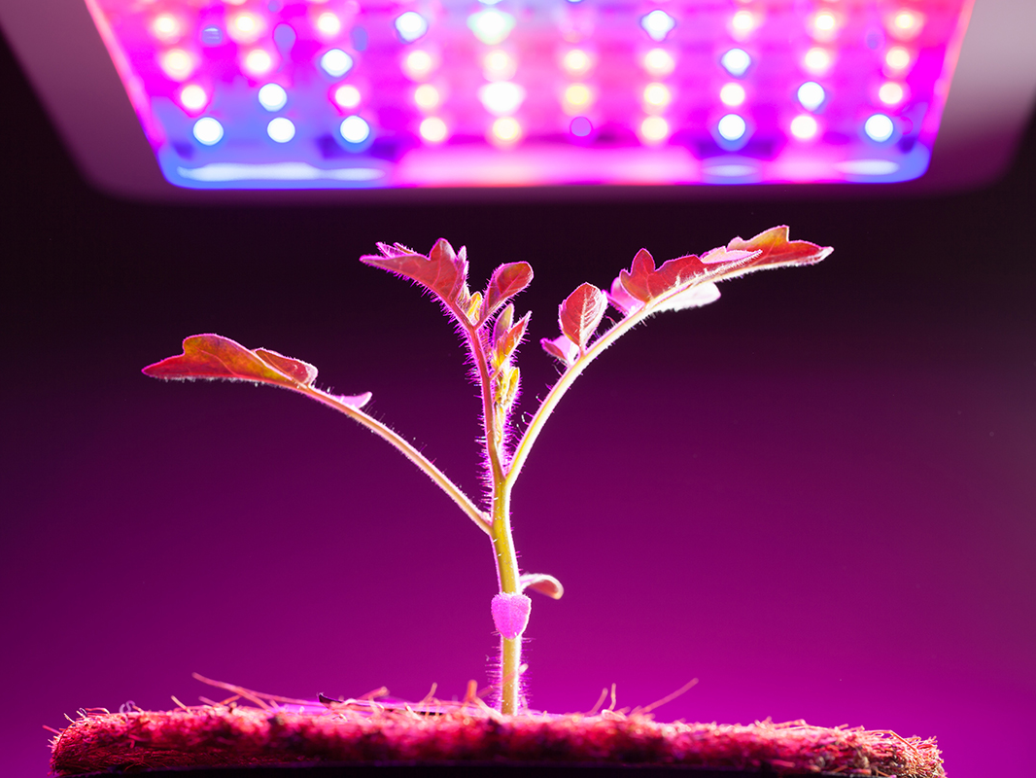
Plant growth using grow lights

Slide 13
LED grow lights
Early research concerning the effects of different light spectra on plants found that red and blue lights offer the best support for photosynthesis, which is the process used by plants to transform light into the energy needed for growth and flowering.
The primary benefits of LED, over the more established light sources, are significantly reduced heat and reduced power consumption. Because they produce less heat, they are more energy efficient and require significantly less expense to ventilate and cool.

Slide 14
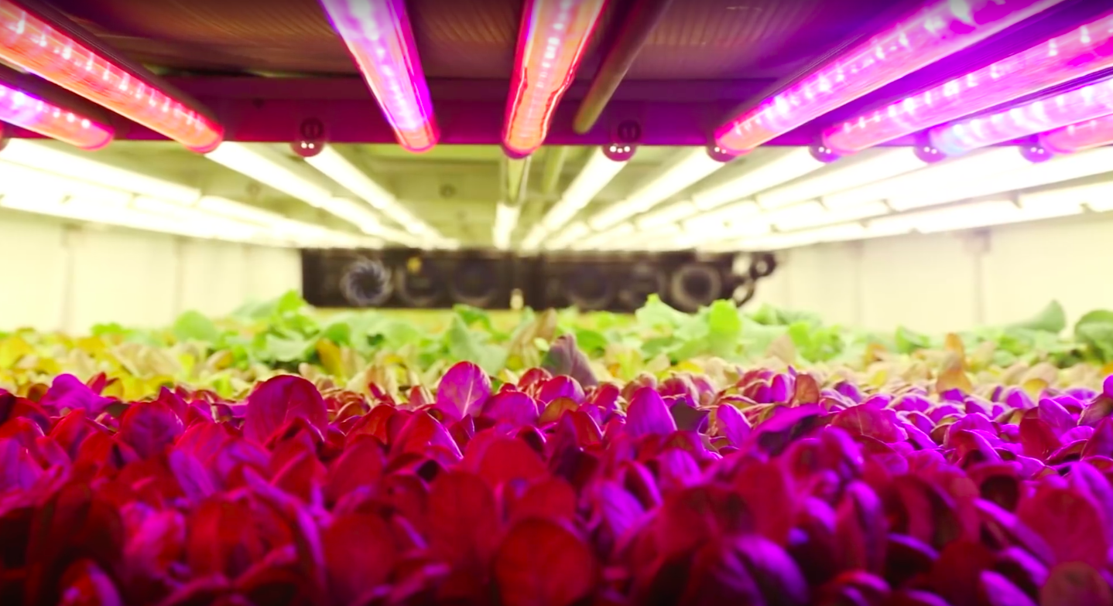
LED lights are used to create a specific light recipe for each plant, giving the greens exactly the spectrum, intensity, and frequency they need for photosynthesis in the most energy-efficient way possible.
This engineered lighting allows us to control size, shape, texture, colour, flavour, and nutrition with razor-sharp precision and increased productivity.

Slide 15
Further investigation pinpointed more specific effects of different light wavelengths on plants grown indoors. The findings of these study provide the basis of LED light recipes:
Red Light (630 -660 nm) is essential for the growth of stems, as well as the expansion of leaves. This wavelength also regulates flowering, dormancy periods, and seed germination.
Blue Light (400 -520 nm) needs to be carefully mixed with light in other spectra since overexposure to light in this wavelength may stunt the growth of certain plant species. Light in the blue range also affects the chlorophyll content present in the plant as well as leaf thickness.
Green Light (500 – 600 nm) was once thought not to be necessary for plants, but recent studies have discovered this wavelength penetrates through thick top canopies to support the leaves in the lower canopy.
Far Red Light (720 – 740 nm) also passes through dense upper canopies to support the growth of leaves located lower on the plants. In addition, exposure to IR light reduces the time a plant needs to flower. Another benefit of far red light is that plants exposed to this wavelength tend to produce larger leaves than those not exposed to light in this spectrum.

